Slide 1

Sentiment Analysis
From Raw Text to Regression with PyTorch & scikit-learn

Slide 2
The Goal
Predict a continuous sentiment score from -1.0 (Negative) to +1.0 (Positive).

Slide 3
Our End-to-End Pipeline
Vectorize
Train & Predict
Apply N-grams & convert tokens to TF-IDF vectors.
Optimize on training data and run inference.
Preprocess
Build Model
Clean, tokenize, and lemmatize raw text.
Create a PyTorch feedforward neural network.

Slide 4

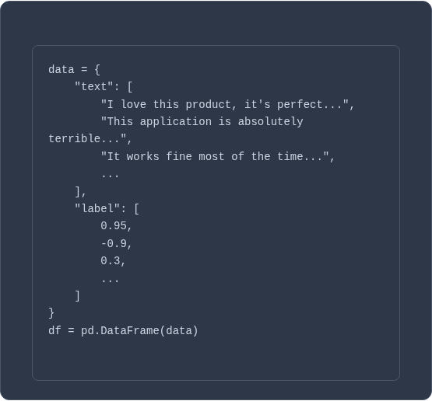
Step 1: The Raw Data
Text & Labels
We start with a `pandas.DataFrame` containing two columns:
•
text: The raw, unprocessed user feedback.
•
label: A pre-assigned sentiment score from -1.0 to 1.0.
This is a regression task, not classification, as we are predicting a continuous value.

Slide 5






Concept 1: The Preprocessing Problem
Words vs. Numbers
Ambiguity
Context
Computers don't understand "love" or "terrible". They only understand numbers.
Are "love", "loving", and "loved" three different words or one concept?
How does a model know that "not good" is negative, but "not bad" is positive?

Slide 6
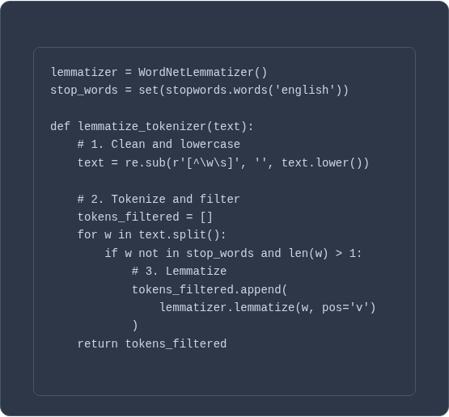
Solution: Lemmatization
What is it?
Lemmatization is the process of grouping together the different inflected forms of a word so they can be analyzed as a single item.
It reduces the "vocabulary" and helps the model generalize.
•
"waited" -> "wait"
•
"bugs" -> "bug"
•
"features" -> "feature"

Slide 7
Concept 2: The Context Problem
"The service was not bad at all."
"
"
If the model only sees "not" and "bad" as separate words, it might misinterpret the sentiment.

Slide 8






Solution: N-grams
Unigram (1-gram)
Bigram (2-gram)
Trigram (3-gram)
"service", "not", "bad", "all"
"service not", "not bad", "bad all"
"service not bad", "not bad all"

Slide 9

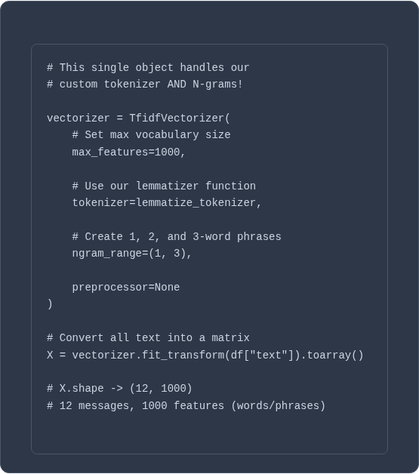
Concept 3: Vectorization (TF-IDF)
What is it?
TF-IDF (Term Frequency-Inverse Document Frequency) converts our tokens and N-grams into a numerical vector.
It assigns a "weight" to each word/phrase. Words that are common everywhere (like "the") get a low weight, while words that are unique and important to a document (like "terrible") get a high weight.

Slide 10

Concept 4: The Model (PyTorch)
SentimentNet
We use a simple Feedforward Neural Network built with PyTorch.
•
Input: The 1000-feature TF-IDF vector.
•
Hidden Layers: Two `nn.Linear` layers (128 and 64 nodes) with `ReLU` activation to find non-linear patterns.
•
Output: A single node with a `tanh` activation, which squashes the final score perfectly into our -1.0 to 1.0 range.

Slide 11

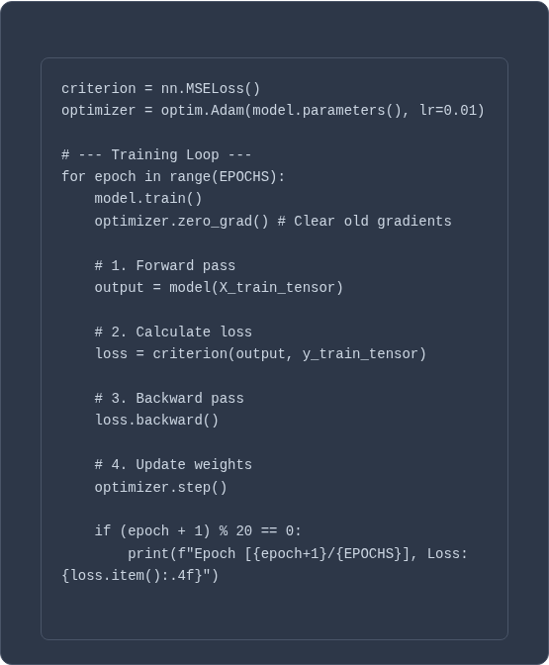
Concept 5: Training the Model
How it Learns
We show the model our data 100 times (Epochs).
1.
Forward Pass: The model makes a prediction.
2.
Calculate Loss: `MSELoss` (Mean Squared Error) measures how "wrong" the prediction was compared to the true label.
3.
Backward Pass: The model calculates which weights were "responsible" for the error.
4.
Optimizer Step: The `Adam` optimizer slightly adjusts all weights to reduce the error for next time.

Slide 12
Final Results: Inference
Message: 'The support agent was fantastic and solved my issue instantly! I'm delighted.'
Predicted Sentiment: 0.8373 (Positive)
Message: 'This is broken and infuriating. My account is locked and nobody is helping.'
Predicted Sentiment: -0.9221 (Negative)
Message: 'I have no preference about the color of the application.'
Predicted Sentiment: 0.0000 (Neutral)

Slide 13
Beyond TF-IDF
Our model has no concept of *word order*. Let's look at models that do.

Slide 14

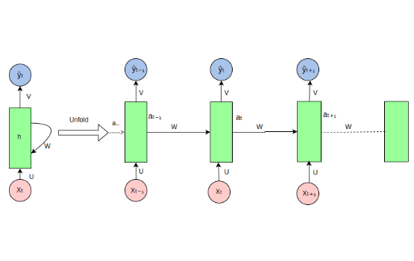
Recurrent Neural Network (RNN)
The "Memory" Loop
An RNN is designed to work with sequences. It processes text one word at a time, and uses a "hidden state" to pass information from one step to the next.
•
How it works: The output for a word is influenced by all the words that came before it.
•
Pros: The first model to effectively handle sequential data.
•
Cons: Suffers from the "vanishing gradient" problem. It has a very short memory and can't remember context from many steps ago (e.g., the beginning of a paragraph).

Slide 15
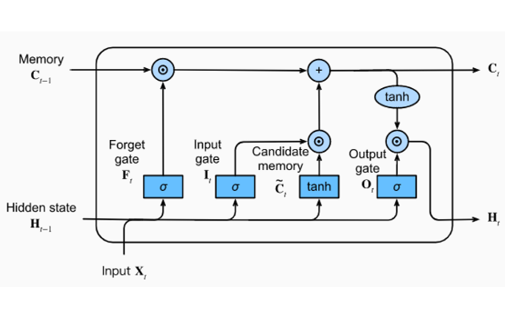
Long Short-Term Memory (LSTM)
The "Gated" Solution
LSTMs are an advanced RNN built to solve the memory problem. They introduce a "cell state" (like a long-term memory conveyor belt) and three "gates".
•
Forget Gate: Decides what old information to throw away.
•
Input Gate: Decides what new information to add to memory.
•
Output Gate: Decides what part of the memory to use for the current prediction.
•
Pros: Can learn and remember long-range dependencies.

Slide 16
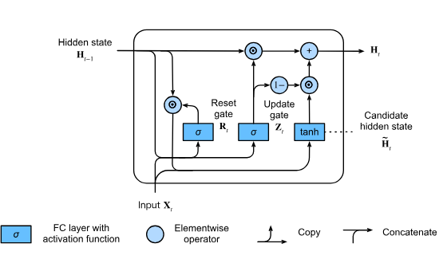
Gated Recurrent Unit (GRU)
The Simplified LSTM
A GRU is a lighter, simpler version of an LSTM. It combines the cell state and hidden state and uses only two gates instead of three.
•
Update Gate: Decides how much of the past memory to keep and how much new information to add (acts like LSTM's Forget + Input gates).
•
Reset Gate: Decides how much of the past memory to *ignore*.
•
Pros: Often performs just as well as an LSTM but is computationally faster and easier to train.

Slide 17
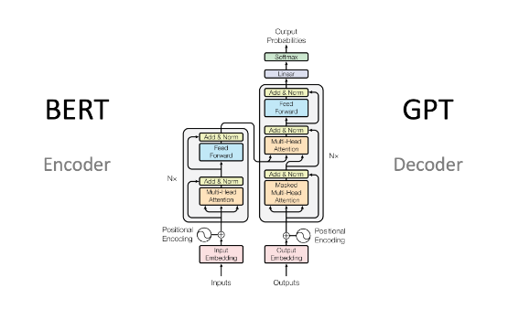
Transformers (SOTA)
"Attention Is All You Need"
This is the state-of-the-art (SOTA) architecture (e.g., BERT, GPT). It abandons recurrence entirely and processes all words at the same time.
•
How it works: Uses a mechanism called "Self-Attention" to look at all other words in the sentence at once, weighing how important each word is to the current word.
•
Pros: Highly parallelizable (fast training), captures extremely complex, long-range context.
•
Cons: Requires massive datasets and computation to train.

Slide 18
Questions?

Slide 19








Image Sources
https://static.vecteezy.com/system/resources/previews/041/448/851/non_2x/abstract-wavy-dynamic-blue-green-violet-light-lines-curve-banner-on-black-background-in-concept-technology-neural-network-neurology-science-music-neon-light-free-vector.jpg
Source: www.vecteezy.com
https://miro.medium.com/1*dznTsiaHCvRc70fxWWEcgw.png
Source: medium.com
https://miro.medium.com/1*Mb_L_slY9rjMr8-IADHvwg.png
Source: medium.com
https://d2l.ai/_images/gru-3.svg
Source: d2l.ai
https://miro.medium.com/0*376uJu_fc_uR8H3X.png
Source: medium.com

